Slide 1

LAPR4 2021/2022 Sprint D
João Beires – 1190718
José Maia – 1191419
José Soares – 1190782
Lourenço Melo - 1190811
06/06/2022

Slide 2

Achievements
User stories completed.
All Work done before deadline.
Improvements in the relationship between members.
Continuos increase in coding quality.

Slide 3
SWOT Format

Slide 4

Leadership
Type: Laissez Faire
Rotative between sprints
Autonomy
Encouraging Aid between members
Achieving the same goal
Frequent Meetings
Liberal

Slide 5

Why this type of leadership?
The team has been the same for some years
Conscience of the members weakness/strengths
There is no storming. The team is in the performing stage.
Greater freedom equals to more results
Aiming to have balance between work and rest.

Slide 6
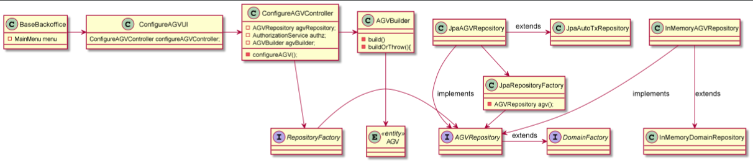
Evidence of Engineering Process

Slide 7

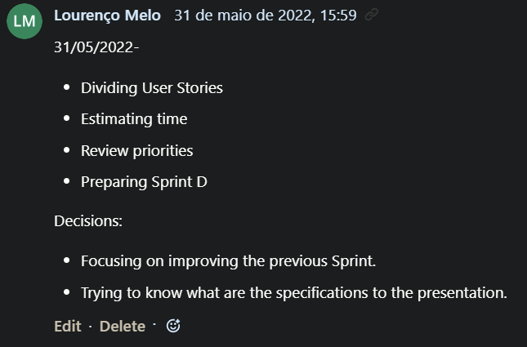
Sprint Cerimonies

Slide 8

Self-Assessement on Behavioral/Technical Skills
Description:
1-very weak; 2- weak; 3-fair; 4-good; 5-very good; 6-excellent

Slide 9

Aspirações
Possible Improvements
-Starting Sprints Earlier
-Predicting better the software Design
-Constant working time on the day
-Having constant rest time through the week

Slide 10

Conclusion

Slide 11
Thank You For Your Attention
Any QUESTIONS?

